Slide 1

CSG2344
Project Methods and Professionalism
Project Management – Human Resources
Is a project manager the same as a line manager?
ECU Copyright 2015 – CSG 2344 School of Computer and Security Science

Slide 2
Lecture objectives
To be able to understand the following concepts :
Human resource planning
Acquiring the project team
Developing the project team
Managing the project team
ECU Copyright 2015 – CSG 2344 School of Computer and Security Science

Slide 3
Project Human Resource (HR) Management
Many corporate executives say
“People are our most important asset.”
People determine the success and failure of organizations and projects.
Project human resource management is concerned with making effective use of the people involved with a project.
ECU Copyright 2015 – CSG 2344 School of Computer and Security Science

Slide 4
What is Project HR Management?
Human resource planning:
  Identifying and documenting project roles, responsibilities, and reporting relationships.
Acquiring the project team:
  Getting the needed personnel assigned to and working on the project.
Developing the project team:
  Building individual and group skills.
Managing the project team:
  Tracking team member performance, motivating team members, providing timely feedback, resolving issues and conflicts, and coordinating changes to help performance.

Slide 5
HR Planning
Involves identifying and documenting project roles, responsibilities, and reporting relationships.
Outputs include:
  Project organizational chart
  Staffing management plan
    Responsibility assignment matrix
    Resource histogram
ECU Copyright 2015 – CSG 2344 School of Computer and Security Science

Slide 6
Staffing Management Plans
A staffing management plan describes when and how people will be added to and removed from a project.
It describes
  the types of people needed to work on the project,
  the numbers needed for each type of person each month, and
  how these resources will be acquired, trained, rewarded, and reassigned after the project.

Slide 7
Resource Histograms
A resource histogram is a column chart that shows
  the number of resources required for a project over time.
In planning project staffing needs, senior managers often create a resource histogram in which columns represent the number of people needed in each skill category.
By stacking the columns, you can see the total number of people needed each month.
ECU Copyright 2015 – CSG 2344 School of Computer and Security Science

Slide 8
Responsibility Assignment Matrices
A responsibility assignment matrix (RAM) is a matrix that maps the work of the project as described in the work breakdown structure (WBS) to the people responsible for performing the work.
For smaller projects, it is best to assign WBS activities to individuals; for larger projects, it is more effective to assign the work to organizational units or teams.
ECU Copyright 2015 – CSG 2344 School of Computer and Security Science

Slide 9

RACI Charts
RACI charts are a type of RAM that show Responsibility, Accountability, Consultation, and Informed roles for project stakeholders.
ECU Copyright 2015 – CSG 2344 School of Computer and Security Science

Slide 10
Sample RACI Chart
 | Group A | Group B | Group C | Group D | Group E
Test Plans | R | A | C | C | I
Unit Test | C | I | R | A | I
Integration Test | A | R | I | C | C
System Test | I | C | A | I | R
User Acceptance Test | A | I | C | R | A
R = Responsibility, only one R per task
A = Accountability
C = Consultation
I = Informed

Slide 11
Acquiring the Project Team
Acquiring qualified people for teams is crucial.
The project manager who is the smartest person on the team has done a poor job of recruiting! Do you think that statement is true?
Good hiring procedures are important
  Staff development and promotion plans
  Incentives for recruiting and retention
  Some organizations allow people to work from home
  Company share schemes

Slide 12
Acquiring the Project Team
Size of team?
Skills desired in team members
  technology skills
  business/organization skills
    Knowledge of the project domain
  interpersonal skills
Hiring managers say interpersonal skills are the most important soft skill for IT workers.
ECU Copyright 2015 – CSG 2344 School of Computer and Security Science

Slide 13

Understanding each team member
Educational background
Project experience
Personality traits/life experience
Professional strengths and weaknesses
ECU Copyright 2015 – CSG 2344 School of Computer and Security Science

Slide 14
Matching roles to people
Requirements/design engineer
  Elicits, clarifies, maintains requirements/design
Coder
  Implements the design
Quality assurance engineer
  Plans, conducts, reports the results of reviews, tests
  Configuration management
Documenter
Other
  Graphics designer, hardware engineer.

Slide 15
Acquiring the Project Team
Many people are struggling with how to increase and diversify the IT labor pool.
Noted problems include:
  The fact that many IT professionals work long hours and must constantly stay abreast of changes in the field.
  Undesirable stereotypes that keep certain people (for example, women) away from the career field.
  The need to improve benefits, redefine work hours and incentives, and provide better human resource management.
Do you think the IT industry does this well?
ECU Copyright 2015 – CSG 2344 School of Computer and Security Science

Slide 16
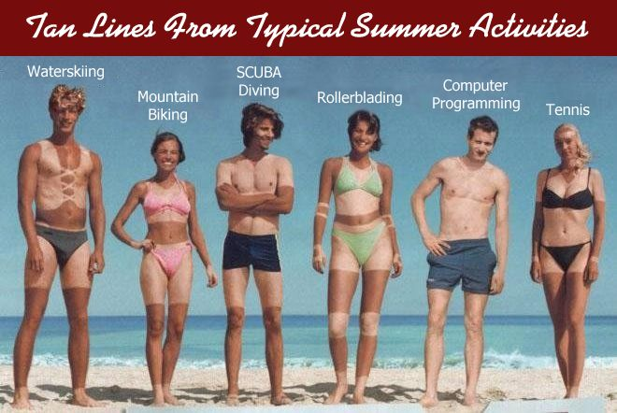

Slide 17
Developing the Project Team
The main goal of team development is to help people work together more effectively to improve project performance.
It takes teamwork to successfully complete most projects.
What feelings might a new employee have?
How can a group of individuals become a hi performing team?
Have you ever been a member of a team working together towards a shared goal?
How would you react if someone had a different idea of how to manage the team?
ECU Copyright 2015 – CSG 2344 School of Computer and Security Science

Slide 18

What makes a team?
A team is more than a group of individuals with...
  A shared goal
  Commitment to each other within the project
  Willingness to learn
These are all values that have to be :
    Developed
    Made explicit
    Nurtured
    Rewarded
ECU Copyright 2015 – CSG 2344 School of Computer and Security Science

Slide 19
Teams also need skills
Expertise in the subject
Knowing how to work as a team
Planning
Conduct of good meetings
Ability to manage logistics and details
Collection and analysis of useful data
Communication of the result
Implementation of changes
ECU Copyright 2015 – CSG 2344 School of Computer and Security Science

Slide 20
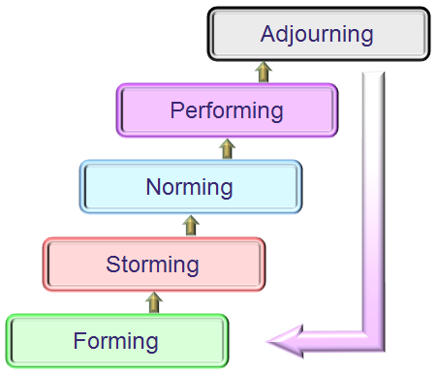
Tuckerman Model
Forming
  getting together, introductions
Storming
  determining how the team should operate,
  sometimes conflict, mistrust at this stage
Norming
  Common working method, cooperation
Performing
  Emphasis on a higher level – goals, loyalty.
  Team better than its parts
Adjourning
  breakup
ECU Copyright 2015 – CSG 2344 School of Computer and Security Science

Slide 21
Training
Successful organisations provide training in all skills
  technology skills
  business/organization skills
  interpersonal skills
Team building activities
  Getting to know one another off site
  Physical challenges etc
ECU Copyright 2015 – CSG 2344 School of Computer and Security Science

Slide 22
Why People Leave Their Jobs
Why do you think people leave their jobs?
They feel they do not make a difference.
They do not get proper recognition.
They are not learning anything new or growing as a person.
They do not like their coworkers.
They want to earn more money.
ECU Copyright 2015 – CSG 2344 School of Computer and Security Science

Slide 23

Managing the Team
Psychologists and management theorists have devoted much research and thought to the field of managing people at work.
Important areas related to project management include:
  Motivation theories
  Influence and power
  Effectiveness
ECU Copyright 2015 – CSG 2344 School of Computer and Security Science

Slide 24
Maslow’s Hierarchy of Needs
Abraham Maslow argued that human beings possess unique qualities that enable them to make independent choices, thus giving them control of their destiny.
Maslow developed a hierarchy of needs, which states that people’s behaviors are guided or motivated by a sequence of needs.
ECU Copyright 2015 – CSG 2344 School of Computer and Security Science

Slide 25
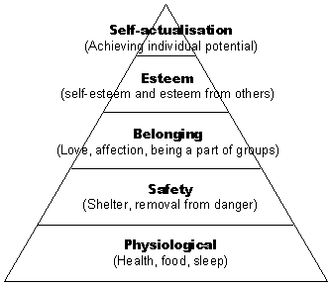
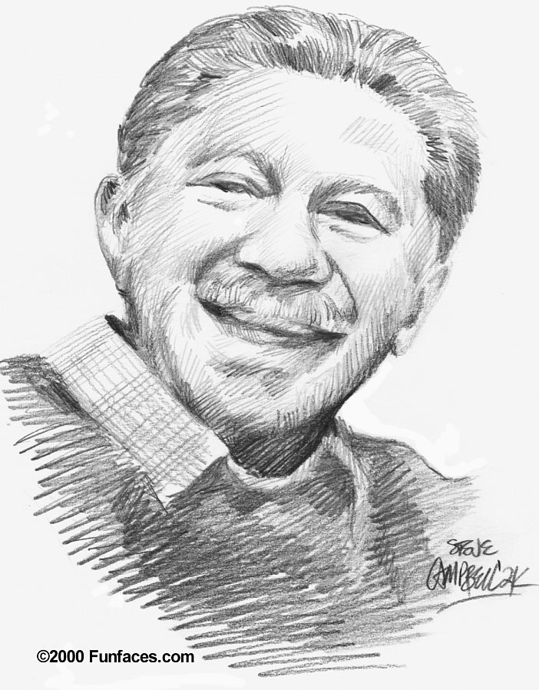
Maslow’s Hierarchy of Needs

Slide 26
Thamhain and Wilemon’s Ways to Have Influence on Projects
Authority: The legitimate hierarchical right to issue orders.
Assignment: The project manager's perceived ability to influence a worker's later work assignments.
Budget: The project manager's perceived ability to authorize others' use of discretionary funds.
Promotion: The ability to improve a worker's position.
Money: The ability to increase a worker's pay and benefits.
ECU Copyright 2015 – CSG 2344 School of Computer and Security Science

Slide 27
Thamhain and Wilemon’s Ways to Have Influence on Projects (cont’d)
Penalty: The project manager's ability to cause punishment.
Work challenge: The ability to assign work that capitalizes on a worker's enjoyment of doing a particular task.
Expertise: The project manager's perceived special knowledge that others deem important.
Friendship: The ability to establish friendly personal relationships between the project manager and others.
ECU Copyright 2015 – CSG 2344 School of Computer and Security Science

Slide 28
Ways to Influence that Help and Hurt Projects
Projects are more likely to succeed when project managers influence people using:
  Expertise
  Work challenge
Projects are more likely to fail when project managers rely too heavily on:
  Authority
  Money
  Penalty
ECU Copyright 2015 – CSG 2344 School of Computer and Security Science

Slide 29
Motivation
You can buy a man's time, you can buy his physical presence at a given place, you can even buy a measured number of his skilled muscular motions per hour
  But you can not buy enthusiasm
  You can not buy loyalty
  You can not buy the devotion of hearts, minds or souls
You must earn these.
Clarence Francis
ECU Copyright 2015 – CSG 2344 School of Computer and Security Science

Slide 30
Reward and Recognition Systems
Team-based reward and recognition systems can promote teamwork.
Focus on rewarding teams for achieving specific goals.
Allow time for team members to mentor and help each other to meet project goals and develop human resources.
ECU Copyright 2015 – CSG 2344 School of Computer and Security Science

Slide 31
Empathic Listening and Rapport
Good project managers are empathic listeners, meaning they listen with the intent to understand.
Before you can communicate with others, you have to have rapport, which is a relation of harmony, conformity, accord, or affinity.
IT professionals need to develop empathic listening and other people skills to improve relationships with users and other stakeholders.
ECU Copyright 2015 – CSG 2344 School of Computer and Security Science

Slide 32
General Advice on Teams
Be patient and kind with your team.
Fix the problem instead of blaming people.
Establish regular, effective meetings.
Allow time for teams to go through the basic team-building stages.
Limit the size of work teams to three to seven members.
ECU Copyright 2015 – CSG 2344 School of Computer and Security Science

Slide 33
General Advice on Teams (cont’d)
Plan some social activities to help project team members and other stakeholders get to know each other better.
Stress team identity.
Nurture team members and encourage them to help each other.
Take additional actions to work with virtual team members.
ECU Copyright 2015 – CSG 2344 School of Computer and Security Science

Slide 34

Summary
Project human resource management includes the processes required to make the most effective use of the people involved with a project.
Main processes include:
  Human resource planning
  Acquiring the project team
  Developing the project team
  Managing the project team
ECU Copyright 2015 – CSG 2344 School of Computer and Security Science

